Slide 1
Graphs

Slide 2
Graphs: Outline
Graph Definitions and Abstract Data Type
Graph Representations
Elementary Graph Operations
Graph Applications
  Minimum Cost Spanning Trees
  Shortest Paths
  Activity Networks

Slide 3
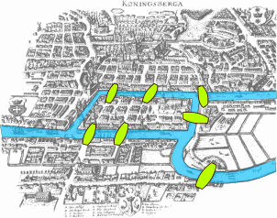
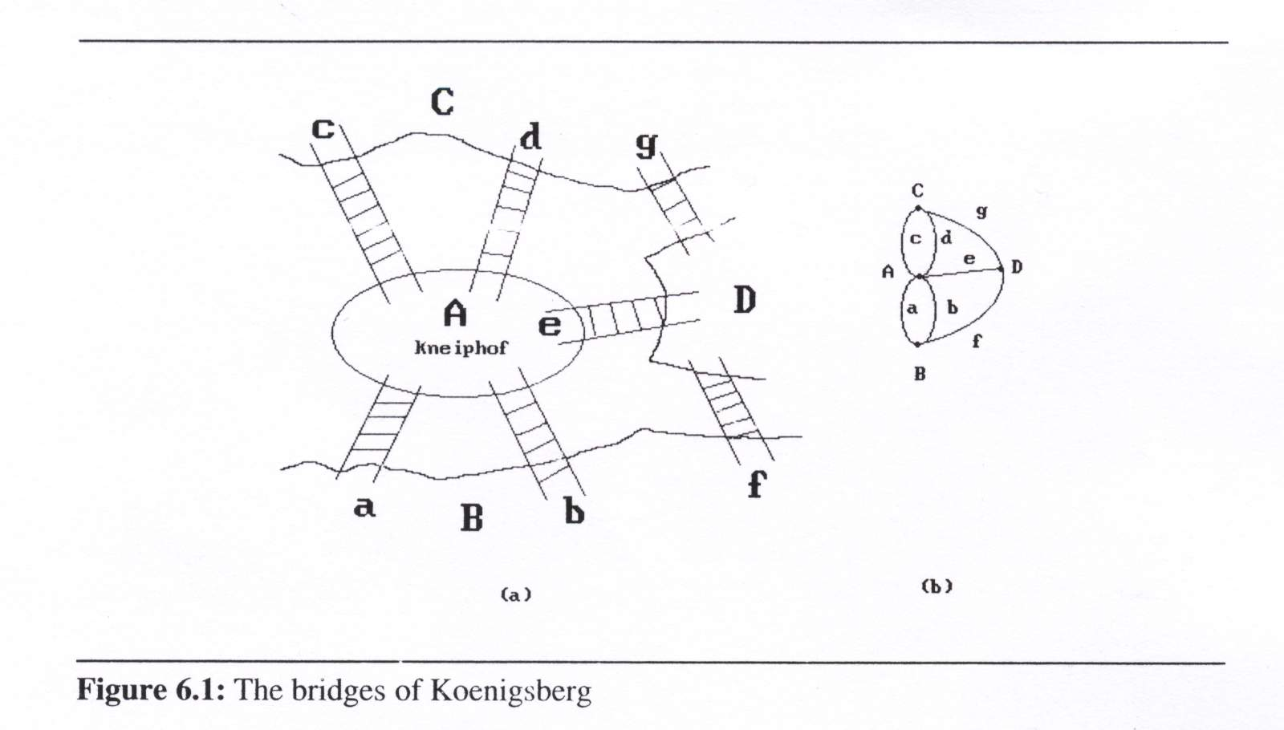
Köenigsberg Bridge Problem
Notes:
3

Slide 4
Graph Definitions
0
A graph G consists of two sets
  a finite, nonempty set of vertices V(G)
  a finite, possible empty set of edges E(G)
G(V,E) represents a graph
An undirected graph
  the pair of vertices in an edge is unordered
  (v₀, v₁) = (v₁,v₀)
A directed graph
  each edge is a directed pair of vertices
  (v₀, v₁) != (v₁,v₀)
1
2
3
0
G1
1
2
G3

Slide 5
Graph Examples
complete undirected graph: n(n-1)/2 edges
complete directed graph: n(n-1) edges
0
0
0
0
1
2
1
1
2
1
2
3
3
4
5
6
2
G1
3
G2
G3
complete graph
incomplete graph
V(G1)={0,1,2,3} E(G1)={(0,1),(0,2),(0,3),(1,2),(1,3),(2,3)}
V(G2)={0,1,2,3,4,5,6} E(G2)={(0,1),(0,2),(1,3),(1,4),(2,5),(2,6)}
V(G3)={0,1,2} E(G3)={<0,1>,<1,0>,<1,2>}
Notes:
5

Slide 6
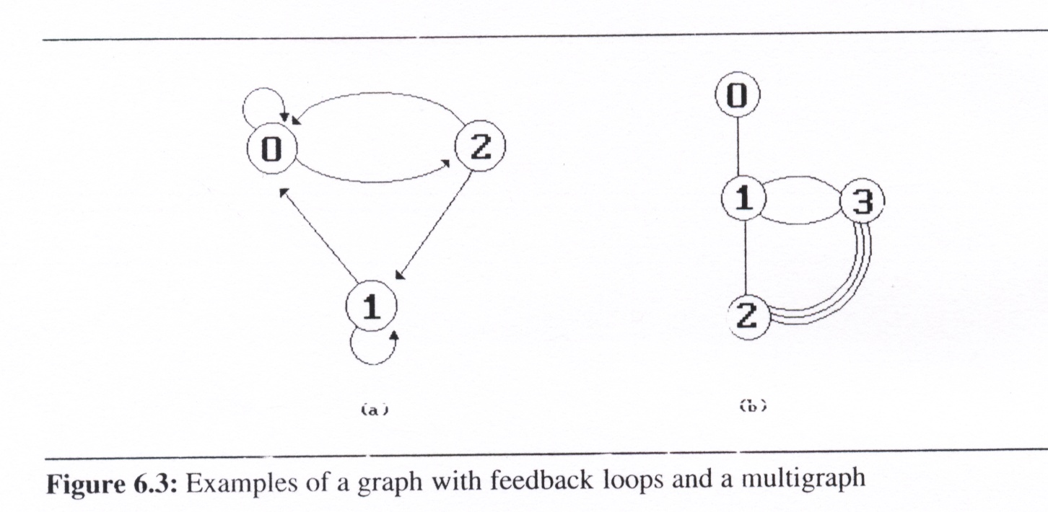
Self Loops and Multigraph
self loops
  an edge from a vertex, i, back to itself.
Multigraph
  multiple occurrences of the same edge.
self loops
multigraph
Notes:
6

Slide 7
Adjacency
If (v0, v1) is an edge in an undirected graph,
  v0 and v1 are adjacent
  The edge (v0, v1) is incident on vertices v0 and v1
If <v0, v1> is an edge in a directed graph
  v0 is adjacent to v1, and v1 is adjacent from v0
  The edge <v0, v1> is incident on v0 and v1
V₀
V₁
V₀
V₁
Notes:
7

Slide 8
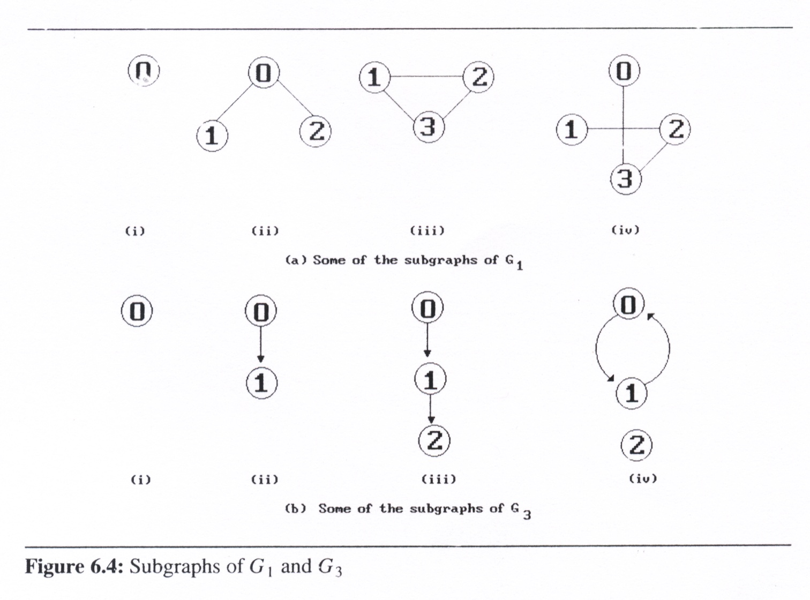
Subgraphs
A subgraph of G is a graph G ’ such that
0
1
2
3
0
1
2
Notes:
8

Slide 9
Path
A path from vertex vp to vertex vq in a graph G
  a sequence of vertices, v_{p}, v_{i1}, v_{i2}, ..., v_{in}, v_{q},
    such that (v_{p}, v_{i1}), (v_{i1}, v_{i2}), ..., (v_{in}, v_{q}) are edges in G
  A path such as (0, 2), (2, 1), (1, 3) is also written as 0, 2, 1, 3
The length of a path is the number of edges on it
0
0
0
1
2
1
2
1
2
3
3
3
Notes:
9

Slide 10
Simple Path and Cycle
simple path (simple directed path): a path in which all vertices, except possibly the first and the last, are distinct.
A cycle (circuit) is a simple path in which the first and the last vertices are the same.
0
1
2
3
Notes:
10

Slide 11
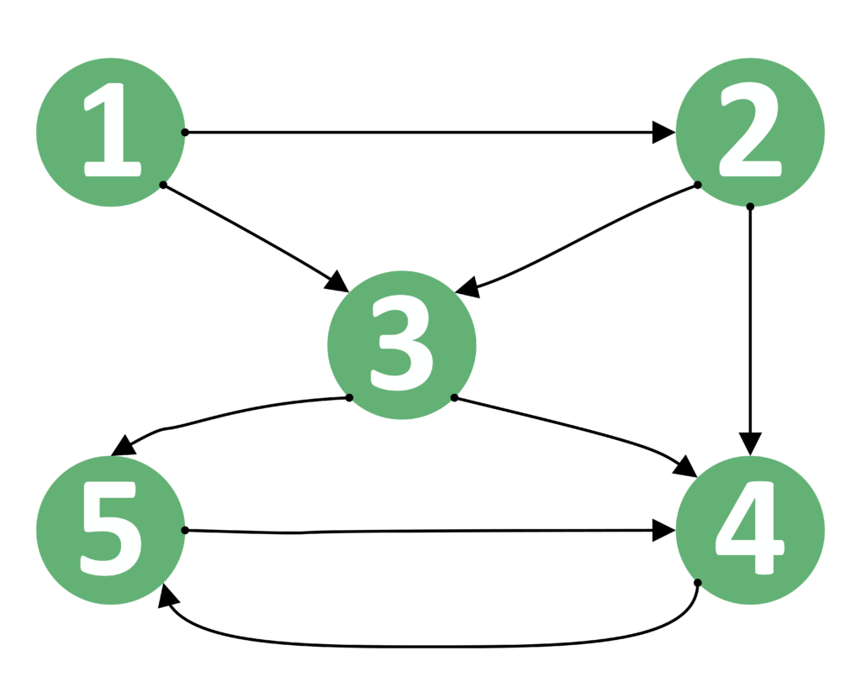
Practice Time
Please find simple paths between vertices 1 and 4:

Slide 12
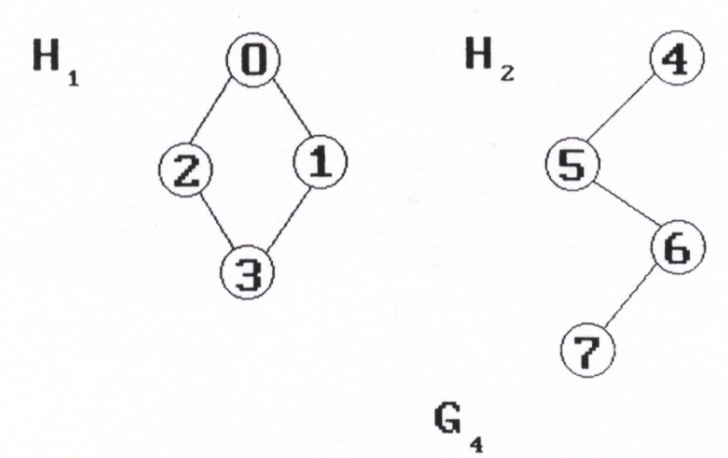
Connected Graph/Component
Connected graph (in undirected graph G)
  Two vertices, v₀ and v₁, are connected
    if there is a path in G from v₀ to v₁
  an undirected graph G is connected
    if, for every pair of distinct vertices v_{i}, v_{j}, are connected
Connected component (in undirected graph)
  A connected component is a maximal connected
  subgraph
  A tree is a graph that is
  connected and acyclic
  (i.e, has no cycle).
Notes:
12

Slide 13
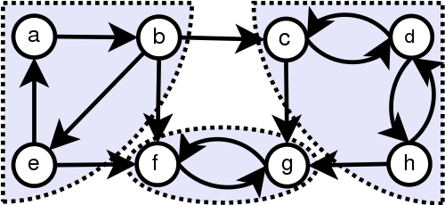
Strongly Connected Component
A directed graph is strongly connected if there is a directed path from v_{i} to v_{j} and from v_{j} to v_{i}
A strongly connected component is a maximal subgraph that is strongly connected
not strongly connected
strongly connected component
(maximal strongly connected subgraph)
0
1
2
G3
Notes:
13

Slide 14
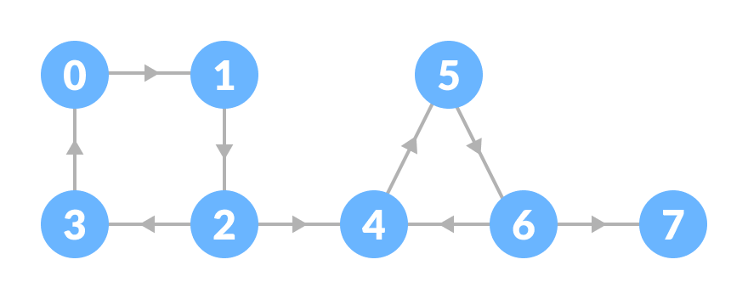
Practice Time
Please find strongly connected components for the graph

Slide 15
Degree of a Vertex
For undirected graph
  The degree of a vertex is the number of edges incident to that vertex
3
2
0
0
3
3
1
2
1
2
3
3
1
1
1
1
3
3
3
4
5
6
G1
G2
Notes:
15

Slide 16
Degree of a Vertex
For directed graph
  in-degree (v) : the number of edges that have v as the head
  out-degree (v) : the number of edges that have v as the tail
0
in:1, out: 1
1
in: 1, out: 2
2
in: 1, out: 0
G3
Notes:
16

Slide 17
Degree of a Vertex
A graph G with n vertices and e edges
  If d_{i} is the degree of a vertex i, then the number of edges is
3
0
in:1, out: 1
0
1
in: 1, out: 2
3
1
2
3
3
3
2
in: 1, out: 0
G1
G3
Notes:
17

Slide 18
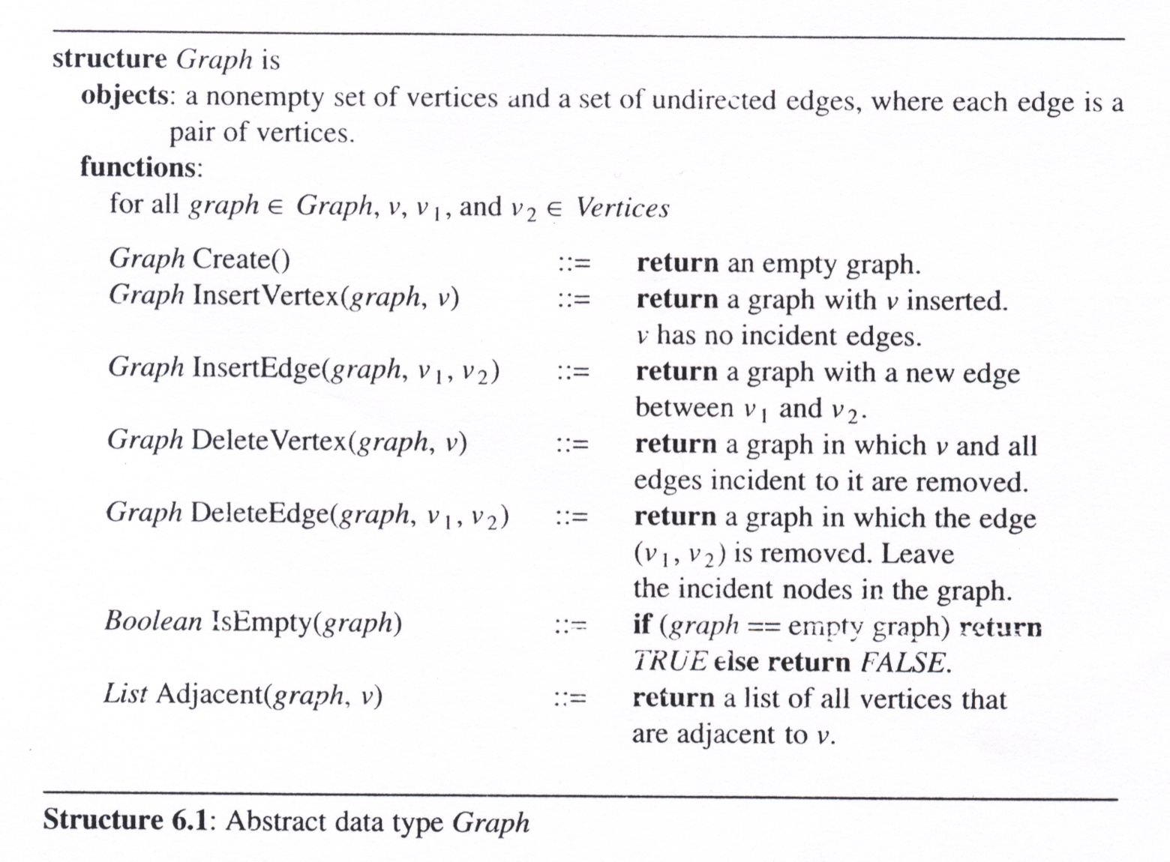
Graph ADT
Notes:
18

Slide 19
Graph Representations

Slide 20
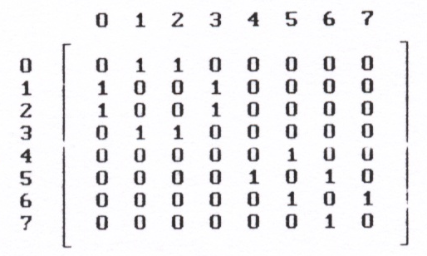
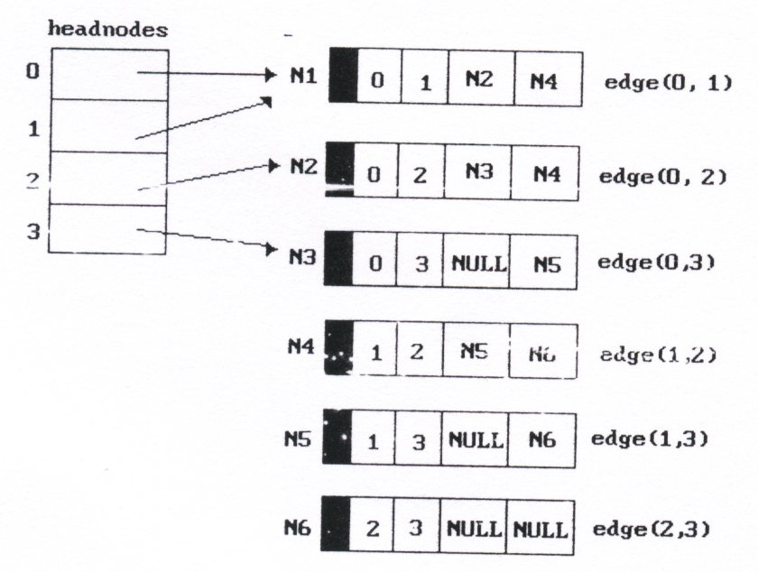
Graph as a Matrix, Lists, and MultiLists
Adjacency Matrix
Adjacency Lists
Adjacency Multilists
0
1
2
3 NULL
1
0
2
3 NULL
2
0
1
3 NULL
3
0
1
2 NULL
0
1 NULL
1
0
2 NULL
2
NULL
0
1
2 NULL
1
0
3 NULL
2
0
3 NULL
3
1
2 NULL
4
5 NULL
5
4
6 NULL
6
5
7 NULL
7
6 NULL
Notes:
20

Slide 21
Graph as Adjacency Matrix
Let G = (V,E) be a graph with n vertices.
  The adjacency matrix of G is a two-dimensional n x n array, say adj_mat, such that
    If the edge (vi, vj) is (not) in E(G), then adj_mat[i][j]=1(0)
0
0
1
2
1
3
2
Notes:
21

Slide 22
Graph as Adjacency Matrix
The adjacency matrix for an undirected graph is symmetric
the adjacency matrix for a digraph may not be symmetric
0
0
1
2
1
3
2
4
0
5
2
1
6
3
7
Notes:
22

Slide 23
Merits of Adjacency Matrix
For an undirected graph, the degree of any vertex, i, is its row sum:
0
1
2
3
4
0
5
2
1
6
3
7
Notes:
23

Slide 24
Merits of Adjacency Matrix
For a directed graph, the row sum is the out-degree, while the column sum is the in-degree.
0
1
2
Notes:
24

Slide 25
Graph as Adjacency Lists Examples
Vertices can be in any order
  Order is of no significance
Head node vertex link
0
•
3 •
1 •
2 NULL
0
1
•
2 •
0 •
3 NULL
1
2
2
•
3 •
0 •
1 NULL
3
3
•
2 •
1 •
0 NULL
Notes:
25

Slide 26
Graph as Adjacency Lists
One list for each vertex in G
  The nodes in list i
    the vertices that are adjacent from vertex i
  For an undirected graph with n vertices and e edges
    requires n head nodes and 2e list nodes
Head node vertex link
0
•
3 •
1 •
2 NULL
0
1
•
2 •
0 •
3 NULL
1
2
2
•
3 •
0 •
1 NULL
3
3
•
2 •
1 •
0 NULL
Notes:
26

Slide 27
Graph as Adjacency Lists
Head nodes vertex link
0
•
3 •
1 •
2 NULL
#define MAX_VERTICES 50 /* Max # of Vertices */
typedef struct node *node_pointer;
typedef struct node {
int vertex;
struct node *link;
};
node_pointer graph[MAX_VERTICES]; (Head nodes)
int n = 0; /* vertices currently in use */
Notes:
27

Slide 28
Adjacency Lists Examples
0
0
1
2
3 NULL
1
2
1
0
2
3 NULL
2
0
1
3 NULL
3
3
0
1
2 NULL
0
0
1 NULL
1
1
0
2 NULL
2
NULL
2
Notes:
28

Slide 29
Practice Time
Please draw the adjacency lists for the graph
Please draw the adjacency lists for the graph
0
4
2
1
5
0
1
2 NULL
3
6
1
0
3 NULL
2
0
3 NULL
7
3
1
2 NULL
4
5 NULL
5
4
6 NULL
6
5
7 NULL
7
6 NULL
Notes:
29

Slide 30
Adjacency Lists Operations
degree of a vertex in an undirected graph
  # of nodes in adjacency list
0
0
1
2
3 NULL
1
2
1
0
2
3 NULL
2
0
1
3 NULL
3
3
0
1
2 NULL
Notes:
30

Slide 31
Adjacency Lists Operations
out-degree of a vertex in a directed graph
  # of nodes in its adjacency list
in-degree of a vertex in a directed graph
  Need to traverse the whole data structure
0
0
1 NULL
1
1
0
2 NULL
2
NULL
2
Notes:
31

Slide 32
Inverse Adjacency List
Finding In-degree of Vertices
  # of nodes in the inverse adjacency list
0
0
1
2
1 NULL
1
0 NULL
1 NULL
2
Notes:
32

Slide 33
Inverse Adjacency List
Finding In-degree of Vertices
  # of nodes in the inverse adjacency list
0
0
1
2
1 NULL
1
0 NULL
1 NULL
2
tail head column link for head row link for tail
Notes:
33

Slide 34
Adjacency Lists Examples
0
Represent both lists of a digraph using only one adjacency list
1
tail head column link for head row link for tail
2
0
1
2
0
0 1 NULL NULL
1
1 0 NULL
1 2 NULL NULL
2 NULL
Notes:
34

Slide 35
Adjacency Lists Examples
0
0
1
2
1
0
0 1 NULL NULL
2
1
1 0 NULL
1 2 NULL NULL
2 NULL
Corresponding adjacency matrix presentation
Notes:
35

Slide 36
Adjacency MultiLists
Each edge/arc is represented by one node
Each node is linked to another node that is incident to one of the two vertices.
  Follow path1 link to the next node containing vertex1
  Follow path2 link to the next node containing vertex2
marked | vertex1 | vertex2 | path1 | path2
Notes:
36

Slide 37
Example of Adjacency Multilists
marked | vertex1 | vertex2 | path1 | path2
Head nodes
 | 0 | 1 | M2 | M4
M1: edge (0, 1)
0
1
 | 0 | 2 | M3 | M4
M2: edge (0, 2)
0
2
3
 | 0 | 3 | NULL | M5
M3: edge (0, 3)
1
2
 | 1 | 2 | M5 | M6
M4: edge (1, 2)
3
 | 1 | 3 | NULL | M6
M5: edge (1, 3)
 | 2 | 3 | NULL | NULL
M6: edge (2, 3)
The lists are: vertex 0: M1 → M2 → M3
vertex 1: M1 → M4 → M5
vertex 2: M2 → M4 → M6
vertex 3: M3 → M5 → M6
N nodes ➔ N paths
Notes:
37

Slide 38
Adjacency MultiLists
marked | vertex1 | vertex2 | path1 | path2
typedef struct edge *edge_pointer;
typedef struct edge{
short int marked; /* denote if node has been */
int vertex1, vertex2; /* visited */
edge_pointer path1, path2;
}
edge_pointer graph[MAX_VERTICES];/* Head nodes */
Notes:
38

Slide 39
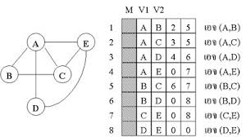
Practice Time
Please draw the adjacency multilists for the graph

Slide 40
Network
The edges of a graph may have weights assigned to them. These weights may represent
    the distance from one vertex to another
    cost of going from one vertex to an adjacent vertex.
To store the weights
  adjacency matrix: store in adj_mat[i][j]
  adjacency lists: add a weight field
A graph with weighted edges is called a network
Notes:
40

Slide 41
Graph Operations
DFS/BFS Traversal & Spanning Trees

Slide 42
Graph Operations
Traversals
  Depth First Search (DFS): preorder traversal
  Breadth First Search (BFS): level order traversal
Spanning Trees
Biconnected Components
Notes:
42

Slide 43
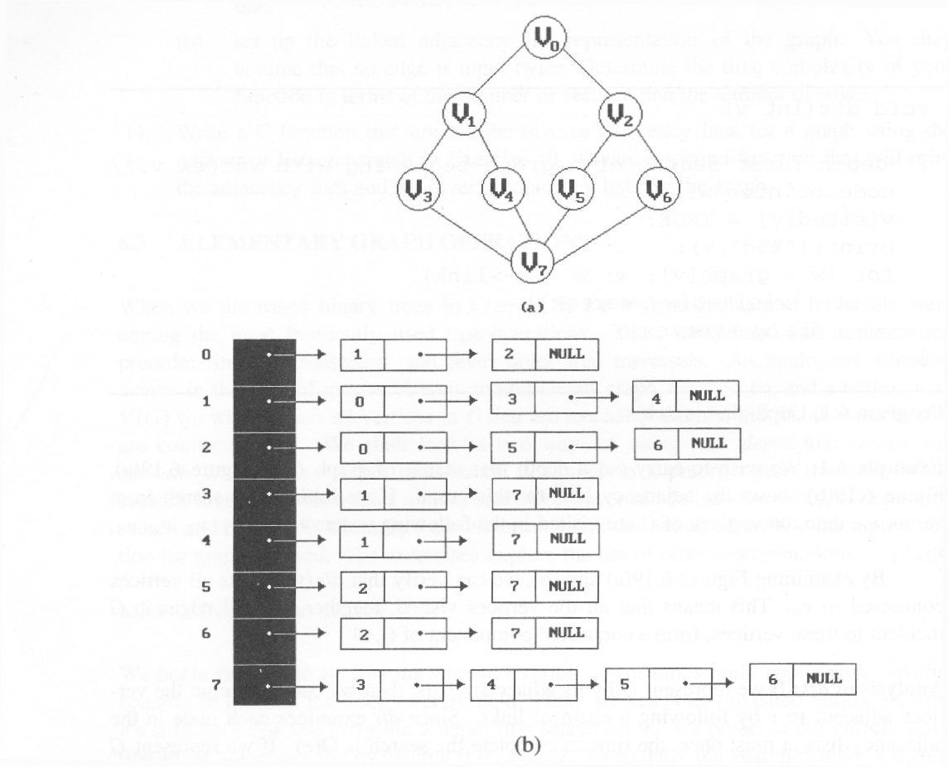
Graph Traversals
Assume Adjacency List representation of Graph
depth first search (DFS): v₀, v₁, v₃, v₇, v₄, v₅, v₂, v₆
0
1
2 NULL
1
0
3
4 NULL
2
0
5
6 NULL
3
1
7 NULL
4
1
7 NULL
5
2
7 NULL
6
2
7 NULL
7
3
4
5
6 NULL
Notes:
43

Slide 44
Depth First Search (DFS)
Need a way to remember previously visited nodes
  Save them in a Stack OR
  Recursive function (system stack)
void dfs (int v) {
/* depth first search of a graph */
node_pointer w;
visited[v] = TRUE;
printf(“%5d”, v);
for (w=graph[v]; w; w=w->link)
if (!visited[w->vertex])
dfs(w->vertex);
}

Slide 45
Tracing DFS
0
1
2 NULL
1
0
3
4 NULL
w
2
0
5
6 NULL
3
1
7 NULL
4
1
7 NULL
5
2
7 NULL
6
2
7 NULL
7
3
4
5
6 NULL
void dfs (int v){
node_pointer w;
visited[v] = TRUE;
printf (“%5d”, v);
for (w=graph[v]; w; w=w->link)
if (!visited[w->vertex])
dfs(w->vertex);
}
visited:
[0]
[1]
[2]
[3]
[4]
[5]
[6]
[7]
output:
0
1
3
7
4
5
2
6
Notes:
45

Slide 46
Graph Traversals
Assume Adjacency List representation of Graph
0
1
2 NULL
1
0
3
4 NULL
2
0
5
6 NULL
3
1
7 NULL
4
1
7 NULL
5
2
7 NULL
6
2
7 NULL
7
3
4
5
6 NULL
breadth first search (BFS): v₀, v₁, v₂, v₃, v₄, v₅, v₆, v₇
Notes:
46

Slide 47
Breadth First Search (BFS)
Explore all nodes that are same “distance” away from the starting node, where distance = 1, 2, …
queue is a natural data structure for BFS
  Nodes at incremental distance away are placed in queue in order
visited:
[0]
[1]
[2]
[3]
[4]
[5]
[6]
[7]
out
0
1
2
3
4
5
6
7
in
Notes:
47

Slide 48
Tracing BFS
visited:
[0]
[1]
[2]
[3]
[4]
[5]
[6]
[7]
out
0
1
2
3
4
5
6
7
in
output:
0
1
2
3
4
5
6
7
node_pointer w;
queue_pointer front, rear;
front = rear = NULL; /* initialize queue */
printf (“%5d”, v);
visited[v] = TRUE;
addq (&front, &rear, v);
while (front) {
v = deleteq (&front);
for (w=graph[v]; w; w=w->link)
if (!visited[w->vertex]) {
printf (“%5d”, w->vertex);
addq (&front, &rear, w->vertex);
visited[w->vertex] = TRUE;
}
}
w
Notes:
48

Slide 49
Connected Components
If G is an undirected graph
  to determine whether or not it is connected
    simply dfs or bfs
    then determining if there is any unvisited vertex
void connected (void)
{ /* determine the connected components */
int i;
for (i=0; i<n; i++)
if (!visited[i]) {
dfs (i);
printf (“\n”);
}
}
4
0
5
2
1
6
3
7
Notes:
49

Slide 50
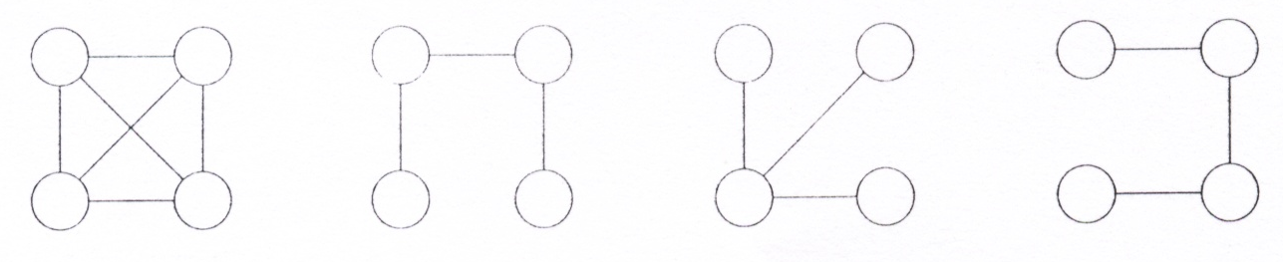
Spanning Trees
if a tree T is a subgraph of G, and T contains all vertices of G, then tree T is a spanning tree of G
E(G): T (tree edges) + N (nontree edges)
    T: set of edges used during search
    N: set of remaining edges
Notes:
50

Slide 51
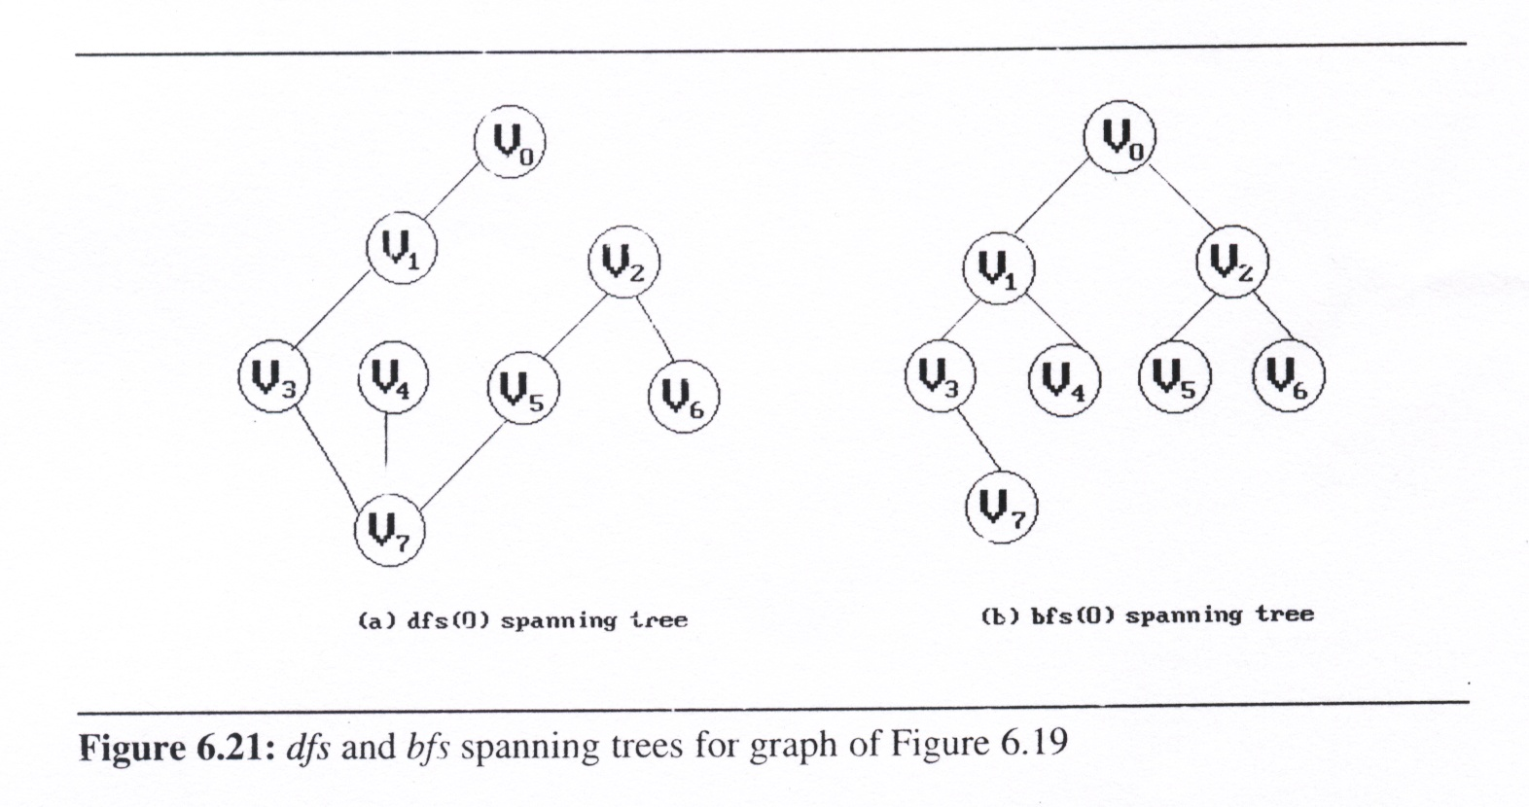
Create Spanning Trees
use DFS or BFS to create a spanning tree
  Depth first spanning tree when DFS is used
  Breadth first spanning tree when BFS is used
Notes:
51

Slide 52
Properties of Spanning Trees
A spanning tree T has n-1 edges (n nodes in the graph)
If a nontree edge (v, w) is inserted into any spanning tree T then a cycle is formed
A spanning tree T is a minimal subgraph G’ of G
  Minimal subgraph: and G’ is connected with fewest number of edges
Notes:
52

Slide 53
Graph Operations
Biconnected Graph

Slide 54
Biconnected Graph
Let G be an undirected, connected graph
  A vertex v of G is an articulation point
    deleting v and all edges incident to v
      will divide the graph G into two or more connected components.
    E.g. all non-leaf nodes of a spanning tree
Notes:
54

Slide 55
Graph with Articulation Points
0
8 9
0
8 9
0
8 9
7
1
7
7
1
1
2
3
5
2
3
5
2
3
5
4
6
4
6
4
6
Connected graph
two connected
components
one connected graph
Articulation Points: nodes 1, 3, 5, 7
Notes:
55

Slide 56
Biconnected Graph
A biconnected graph is a connected graph that has no articulation points.
A biconnected component of a connected graph G is a maximal biconnected subgraph H of G
Notes:
56

Slide 57
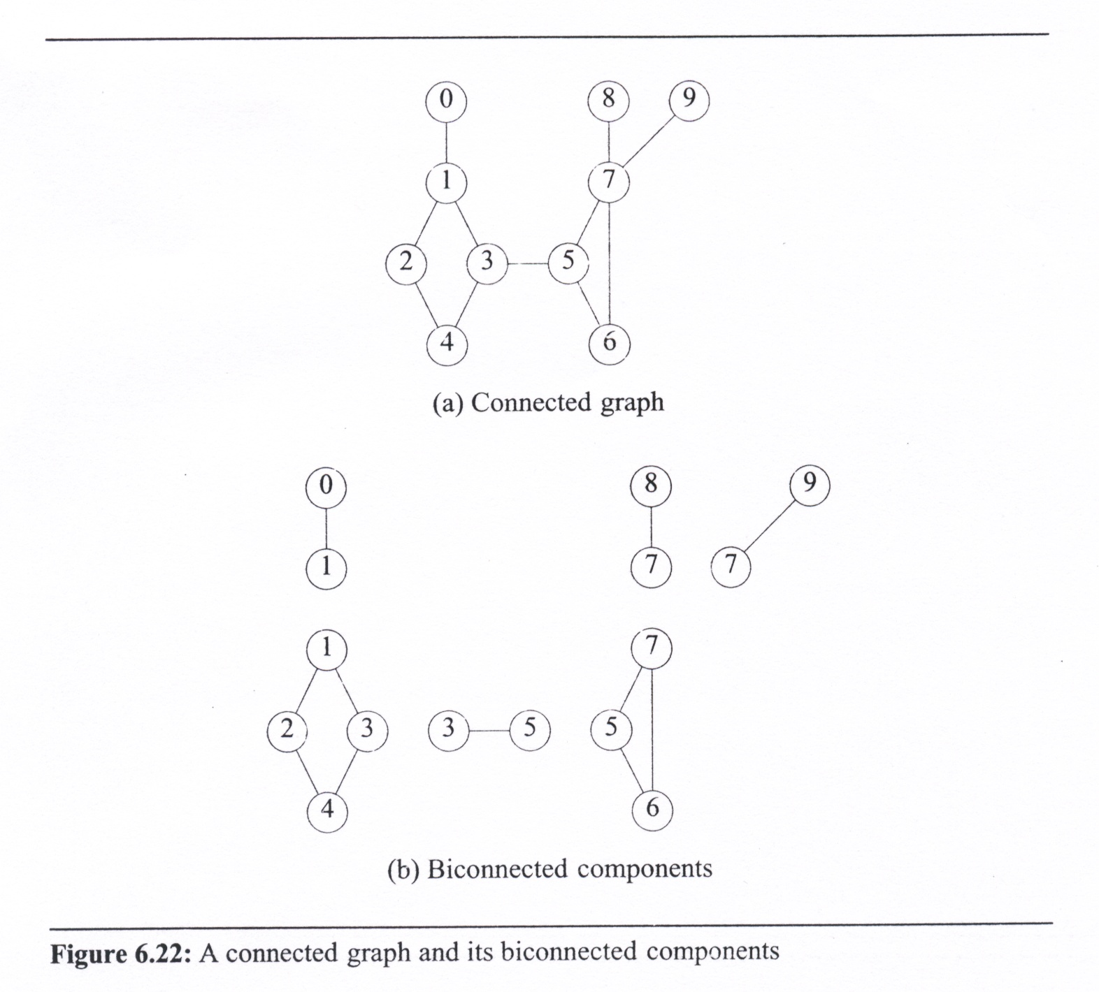
Biconnected Component
A biconnected component H of a graph G is a maximal biconnected subgraph if
  G contins no other subgaph that is both biconnected and properly contains H.
0
8 9
1
7
2
3
5
4
6
Notes:
57

Slide 58
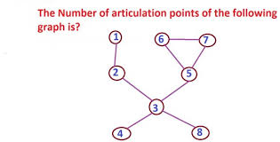
Practice Time

Slide 59
Tree Edges and Back Edges
Spanning tree generated by DFS on a graph
  A nontree edge (u, v) is a back edge
    iff either u is an ancestor of v or v is an ancestor of u.
  All nontree edges are back edges.
3
0
1 5
4
5
2
4
2
6
7
6
1
7
3
8 9
0
9
8

Slide 60
Tree Edges and Back Edges
Articulation point
Root : iff it has at least 2 children
Any other vertex u:
it has at least one child w such that w cannot reach an ancestor of u
by a path that consists of only w, descendants of w, and a single back edge
3
0
1 5
4
5
2
4
2
6
7
6
1
7
3
8 9
0
9
8

Slide 61
Finding Biconnected Components
Step 1: Finding the depth first spanning tree of G
  Define the depth first number (dfn) as the DFS visit sequence
  Note: If u is an ancestor of v then dfn(u) < dfn(v)
9
8
4
0
8
9
3
0
1 5
7
7
4
5
3
1
0
5
5
2
4
2
6
7
6
2
2
3
3
1
7
4
6
8 9
1
6
0
9
8
depth first spanning tree rooted at vertex 3
Notes:
61
2

Slide 62
Finding Biconnected Components
Step 2: Compute low(u) for all nodes.
  low(u): the lowest dfn that can be reached from u by a path of descendants followed by at most one back edge
nontree edge
(back edge)
3
0
Q: What is the results of vertex
4, 7, 8, and 9?
1 5
4
5
2
4
6
7
2
6
3
1
7
8 9
0
9
8
Notes:
62

Slide 63
Finding Biconnected Components
Step 2: Compute low(u) for all nodes.
  low(u) = min{ dfn(u),
  min{ low(w) | w is a child of u },
  min{ dfn(w) | (u, w) is a back edge } }
nontree edge
(back edge)
Q: What is the results of vertex
7, 8, and 9?
3
0
1 5
4
5
vertex | dfn | low | child | low_child
0 | 4 | 4 (4,n,n) | null | null
1 | 3 | 0 (3,4,0) | 0 | 4
2 | 2 | 0 (2,0,n) | 1 | 0
3 | 0 | 0 (0,0,n) | 4,5 | 0,5
4 | 1 | 0 (1,0,n) | 2 | 0
5 | 5 | 5 (5,5,n) | 6 | 5
6 | 6 | 5 (6,5,n) | 7 | 5
7 | 7
8 | 9
9 | 8
2
4
6
7
2
6
3
1
7
8 9
0
9
8
Notes:
63

Slide 64
Finding Biconnected Components
Step 3: Determining articulation points
  If u is the root of the spanning tree and has two or more children
  If u has at least one child w such that low(w) ≥ dfn(u)
  (cannot reach an ancestor of u by a path that consists of only w, descendants of w, or a single back edge)
3
0
1 5
4
5
2
4
6
7
2
6
3
1
7
8 9
0
9
8
Notes:
64

Slide 65
Implementation: Finding B.C.
#define MIN2 (x, y) ((x) < (y) ? (x) : (y))
short int dfn[MAX_VERTICES];
short int low[MAX_VERTICES];
int num;
void init (void) {
int i;
for (i=0; i<n; i++) {
visited[i] = FALSE;
dfn[i] = low[i] = -1;
}
num = 0;
}
Modify depth first search to compute dfn() and low() for each vertex of a connected undirected graph
Invoke dfnlow (x, -1), where x is the starting vertex (root) for the depth first search
Notes:
65

Slide 66
Implementation: dfnlow ()
void dfnlow (int u, int v)
{
node_pointer ptr;
int w;
dfn[u] = low[u] = num++;
for (ptr=graph[u]; ptr; ptr=ptr->link) {
w = ptr->vertex;
if (dfn[w] < 0) {/* w is an unvisited vertex */
dfnlow(w,u);
low[u] = MIN2(low[u],low[w]);
}
else if (w != v)
low[u] = MIN2(low[u],dfn[w]);
}
}
v is the parent of u (if any)
u:
4
0, 1
3
2
1
0
2
1, 2
1
-1
4
v:
3
w:
2, 4
2
0
4
1
3
2
1
0
num:
4, 3
2
3
4
0
1
5
3, -1
w is a child of u
ptr
4
dfn(u)
3
(u, w) is a back edge
2
0
0
1
2
3
4
5
6
7
8
9
dfn:
-1
4
-1
3
-1
2
-1
0
-1
1
-1
-1
-1
-1
-1
low:
-1
1
4
3
2
-1
-1
-1
-1
-1
0
-1
0
-1
-1
1
0
-1
Notes:
66

Slide 67
Practice Time
Start to visit the graph by dfs from vertex 3 and show the dfn and low value for each vertex

Slide 68
Outputting Biconnected Components
Partition the edges of the connected graph into their biconnected components
  In dfnlow, if low[w] ≥ dfn[u], then a new biconnected component is found
  output all edges in a biconnected component
    use a stack to save the edges
    when they are encountered the
    first time
output: <1,0> <1,3> <2,1> <4, 2> <3,4> <7,9>
. . .

Slide 69
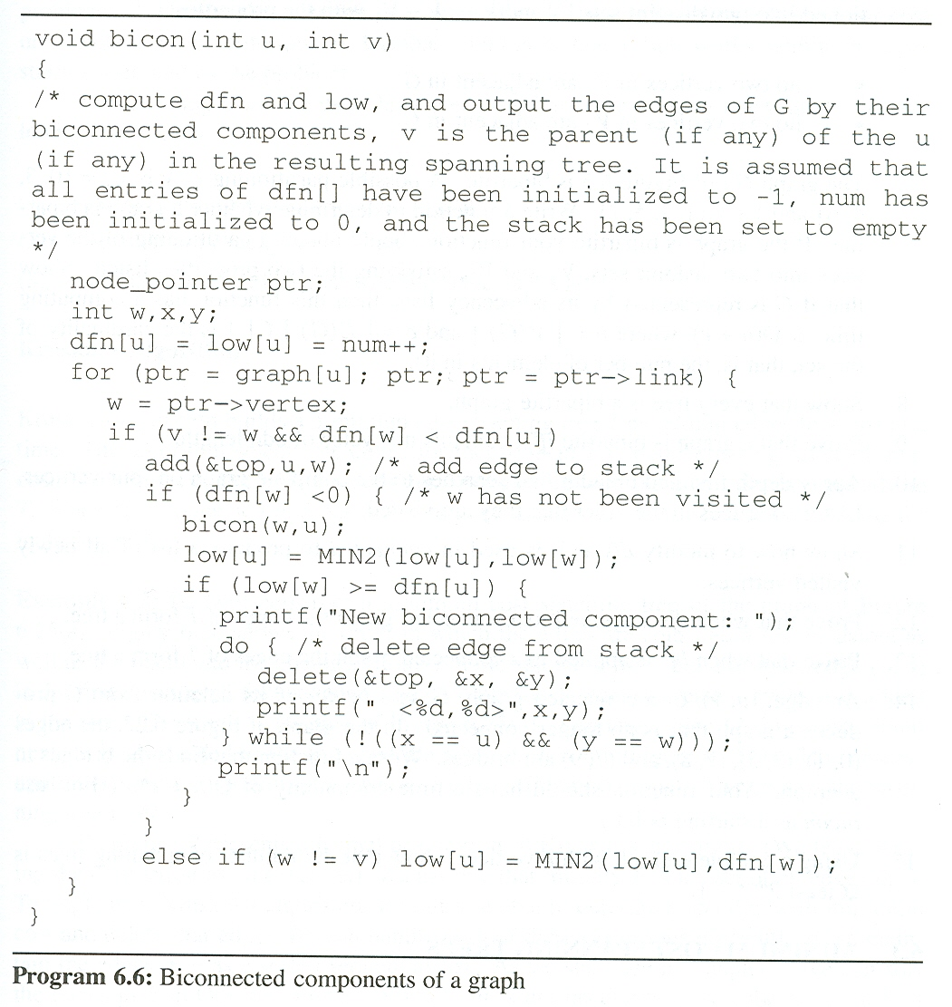
0
1
2
3
4
5
6
7
8
9
bicon(u,v)
dfn:
-1
-1
-1
-1
-1
-1
-1
-1
-1
-1
4
3
2
0
1
5
6
7
9
8
low:
-1
-1
-1
-1
-1
-1
-1
-1
4
3
7
0
2
0
-1
0
-1
0
5
6
1
5
5
9
8
output:
<1, 0>
<1, 3>
<2, 1>
<4, 2>
<3, 4>
u:
3
<7, 9>
<7, 8>
<7, 5>
<6, 7>
<5, 6>
3
4
2
1
0
1
2
4
5
6
7
9
7
8
7
6
5
3
10
13
79
78
75
21
67
42
56
34
35
<3, 5>
-1
-1
-1
3
4
2
1
2
4
3
3
5
6
7
6
7
6
5
3
v:
w:
4
2
1
0
2
3
1
4
2
3
5
6
7
9
7
9
8
7
8
6
5
7
5
6
7
3
1
0
4
5
back edge or not yet visited
num:
0
1
2
3
4
5
6
7
8
9
10
ptr
4
9
8
w is a child of u
3
7
2
0
5
(u, w) is a back edge
6
1
Notes:
69

Slide 70
Practice Time
Find the bi-connected components of the graph

